Slide 1
Identifying Exoplanets
Sean Kendall

Slide 2
Background
What is an exoplanet?
Planet orbiting another star than our Sun
How do you detect exoplanets?
Two main methods:
Radial Velocity
Gravity of the planet pulling on the star that it orbits causes the star to wobble a bit as the planet travels around the star
Transit
Planet blocks a bit of the light from the star as it travels between our telescope and the star, making the star appear a bit dimmer
Both methods favor larger planets (planets with a larger radius)

Slide 3
Background
Could be detecting interference from other stellar bodies or defects in our telescope
How to confirm an object is an exoplanet?
Multiple transits of the object in question
Provides a regular pattern and more data that can be used to confirm the object as a planet
Favors faster planets (planets with shorter years)
Confirmation from multiple telescopes or with multiple detection methods

Slide 4
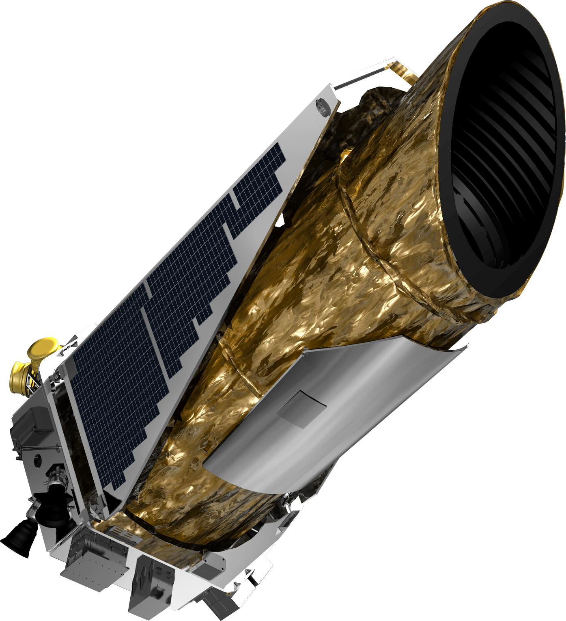
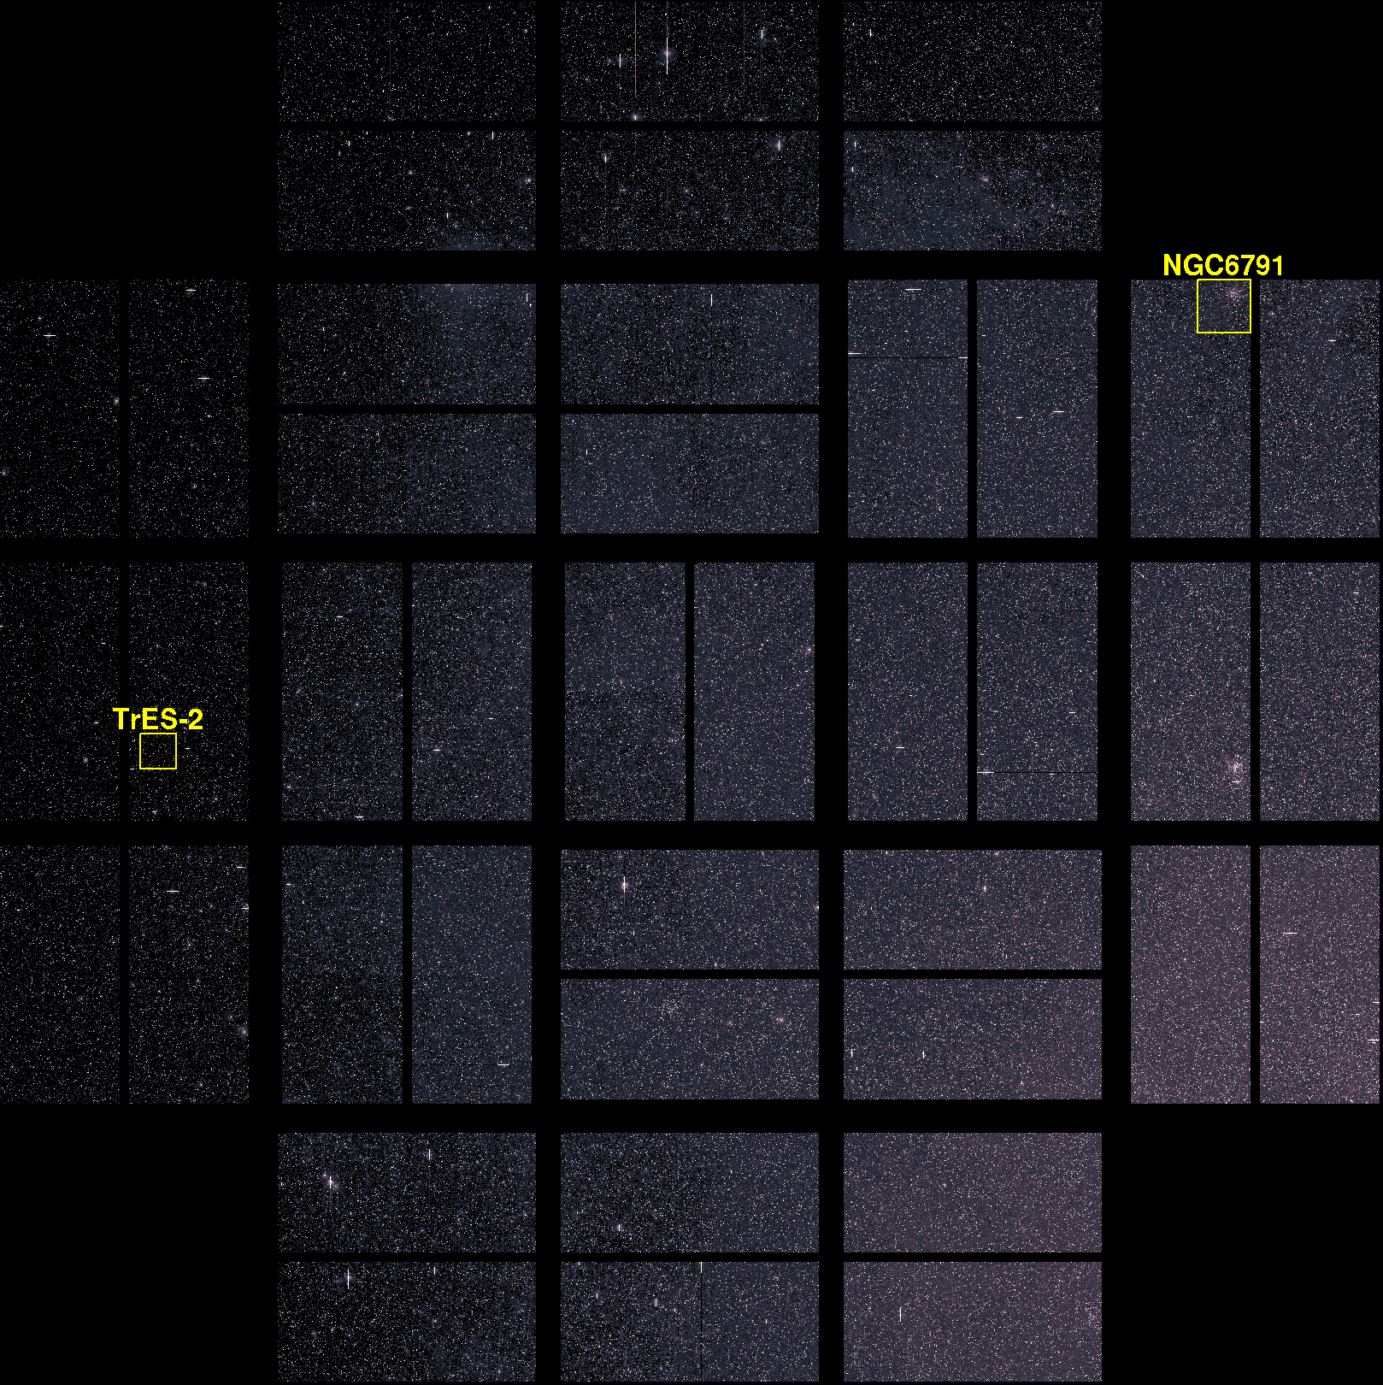
K2 Survey Data
Survey done by the Kepler Space Telescope in its extended mission from 2014-2018
Table includes 2582 objects
371 confirmed as planets
1974 objects which are potentially planets
Use 300 planets as the sample size

Slide 5
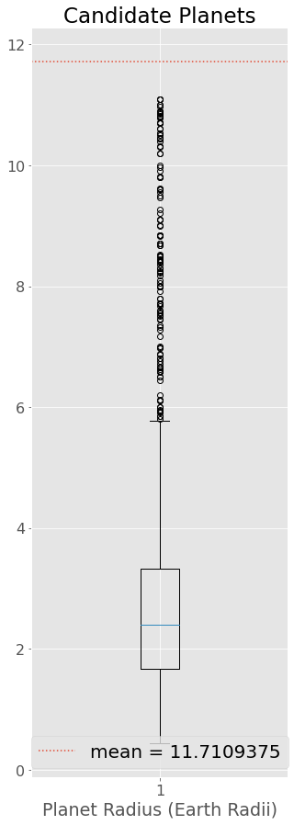
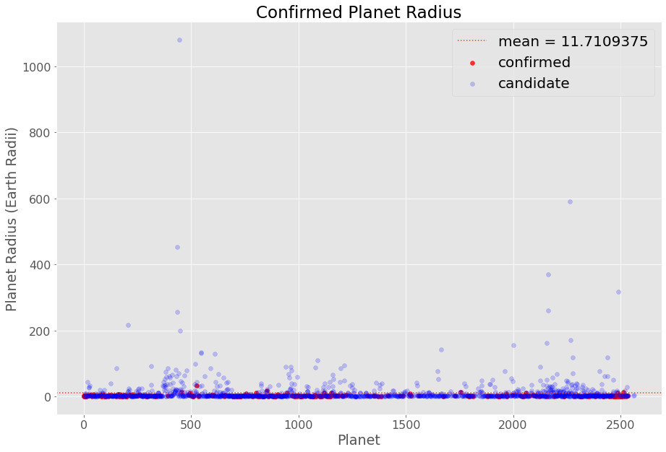
Outliers
Large candidate planet outliers – planet with a 83,830-day year and planet with a radius of 1,080 Earth radii
Filter planets with years <= 1 Earth year (365 days) and <= Jupiter radius (11.2 Earth radii)

Slide 6
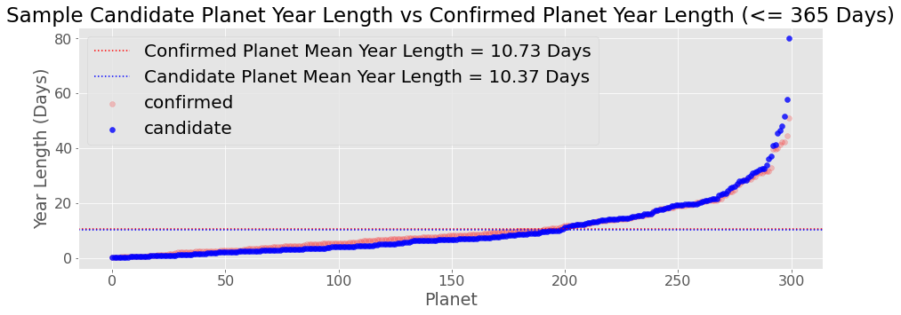
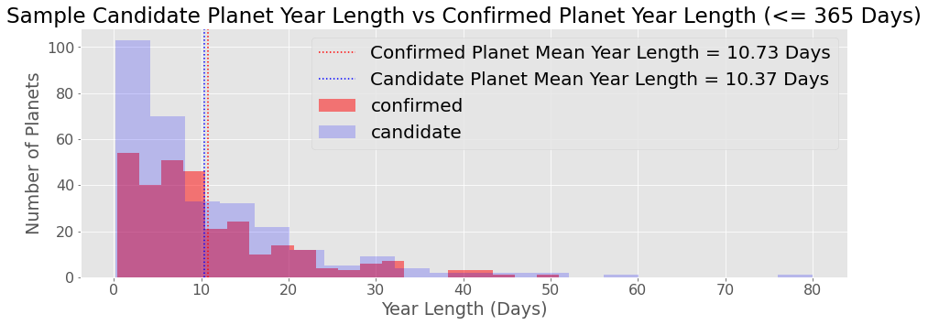
Sample Planet Years

Slide 7
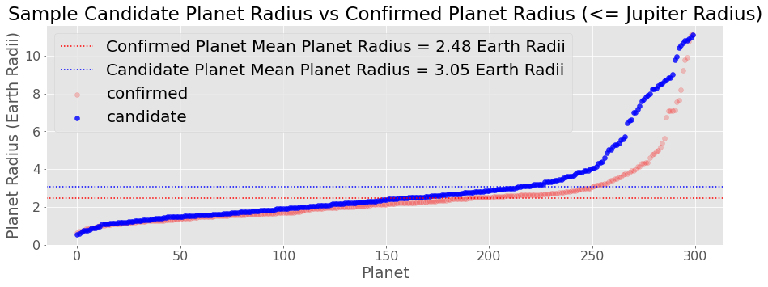
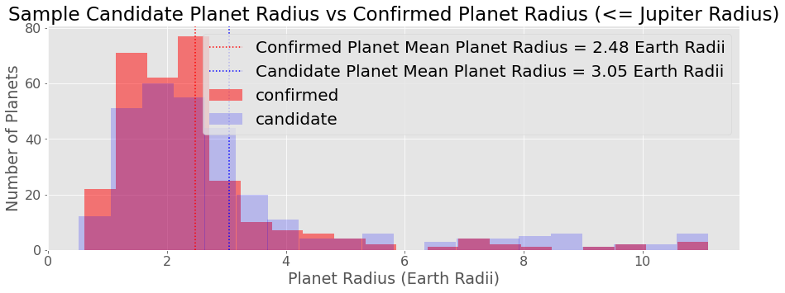
Sample Planet Radii

Slide 8
Patterns and analysis
Correlation between confirmed planet and candidate planet distributions
Using Pearson correlation where the closer the value is 1 to, the more directly correlated the two values are
Planet year length: 0.987 p-value = 1.887e-240
Planet radius: 0.955 p-value = 9.990e-159
Very highly correlated with each other
T-Test between confirmed planet and candidate planet distributions
Using t-test with independent data sets, null hypothesis: confirmed and candidate have the same distributions
Planet year length: statistic = 0.447 p-value = 0.655
Planet Radius: statistic = -3.542 p-value = 0.000
Fail to reject null hypothesis for year length, reject null hypothesis for radius
Candidates are nearly always larger and faster than confirmed planets
Based on comparing the mean size and speed of 1000 different samples
Theoretically easier to confirm candidates than already confirmed planets

Slide 9
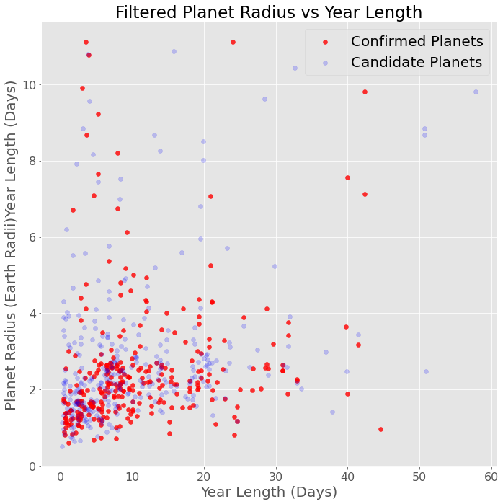
Sample Planet Radius vs Year Length
Filter planets by both planet radius and year length
Only filtered by one or the other before
Compare characteristics
Does a larger planet mean that it orbits take longer?
Are larger planets further from the star?
Correlation between planet year length and planet radius:
0.150 p-value = 0.000
Very slightly positively correlated

Slide 10
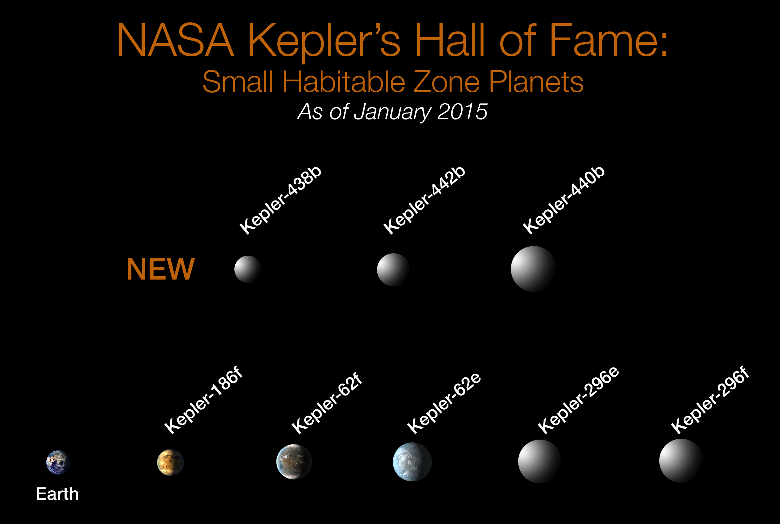
Conclusion
Difficult to identify planets from possible candidates
Many outliers which skew data
Not sure if candidate and confirmed planets have the same distribution
Planet size and speed not highly correlated
Benefits
Could identify planets outside of our solar system which could be Earth-like
Could support life

Slide 11
Works Cited
Data:
https://exoplanetarchive.ipac.caltech.edu/cgi-bin/TblView/nph-tblView?app=ExoTbls&config=k2candidates
https://exoplanets.nasa.gov/what-is-an-exoplanet/in-depth/#otp_how_do_we_find_exoplanets?
https://en.wikipedia.org/wiki/Kepler_space_telescope#Finding_planet_candidates

